Slide 1
Rowing Securely To Shore: Row Level Security in Tableau
Ron Dugger | Sales Consultant
Bryant Howell | Senior Sales Consultant
Miranda Osterheld | Senior Product Consultant

Slide 2
What’s going to be taught (can’t guarantee it’s going to be learned)
Row Level Security Overview
Secure Data Filters in Tableau
Security Entitlements in a Relational Database
Standard Row Level Security in Tableau (JOINing Tables)
Live Connections
Extracts
Non-JOIN Database Techniques
RAWSQL
Stored Procedures
Securely Filtering at Load Time using Parameters
Web Services / REST API Data Sources

Slide 3
Row Level Security Overview

Slide 4
What is Row Level Security?
We hope you won’t rue the role that rows play in this session
We’re really talking about “Data Level Security”
To straighten it all out:
Roles in Tableau are for Permissions. They control what actions you can take in Tableau
Rows are things in a data table, that contain the actual data.
Row Level Security is blocking data someone shouldn’t see

Slide 5
Row Level Security – High Level Process Flow
All Entitlements
All Data
Filter
On User
Filter On Entitlements
User’s Entitlements
User’s Data
Notes:
https://upload.wikimedia.org/wikipedia/commons/thumb/a/a6/Lil_Wayne_%2823513397583%29.jpg/180px-Lil_Wayne_%2823513397583%29.jpg
You need to get from THE USER to that USER’S ENTITLEMENTS, then pass those ENTITLEMENTS to the DATA to be filtered.
To repeat: You are filtering the ENTITLEMENTS on the USER, not the DATA on the User.

Slide 6
If you want to filter rows of data
You need some columns to filter on
Ex.
Category = ‘Furniture’ AND Sub-Category = ‘Bookshelves’ AND Region = ‘North’
Transaction ID | Product ID | Category | Sub-Category | Region
029184819 | 410293184820 | Furniture | Bookshelves | North
029184820 | 423293248241 | Furniture | Bookshelves | South
029184821 | 220001290112 | Furniture | Chairs | North
20918419 | 10101010210 | Office Supplies | Paper Products | North
Notes:
This may seem like too basic of a place to start but the question does come up. The data you connect to in Tableau, must have columns containing what you want to filter on
These columns need to have relevant values you are going to filter on
You may need to join together several tables to get all of the columns you need

Slide 7
Secure Data Filters in Tableau
Notes:
We’re going to go over the most absolute basics of Standard Row Level Security in Tableau, but only because it will help us understand the more advanced use cases. We also have some great articles available that describe how to set it up correctly.

Slide 8
Unbreakable Row Level Security Filters in Tableau
User Calculation or Parameter in Calculated Field (Desktop)
Data Source Filter on Calculated Field (Desktop)
Published Data Source (Server)

Slide 9
User Calculations
Tableau Calculated Fields have access to the following calculations, which return for the logged-in user
USERNAME()
FULLNAME()
ISMEMBEROF()
Example of Calculated Field:
[Username] = USERNAME()

Slide 10
Synchronizing Users into Tableau Server
Every method of Data Level Security uses User Calculations
To use User Calculations, you must create a User in Tableau Server
Several ways to Synchronize Users to Tableau Server
REST API
Active Directory
LDAP
tabcmd
Manually with clicking in the UI

Slide 11
Published Data Sources Are Required
A Tableau Workbook can contain two types of Data Sources:
Embedded: Data source definition lives in the Workbook file
Published: Data Source definition has been published to a Tableau Server
Embedded Data Sources allow an end user with Web Edit or Download to edit Calculated Fields
Row Level Security requires Calculated Fields, so Embedded Data Sources are less secure. Use only if Web Edit / Download will always been disabled

Slide 12
What we won’t be talking about
Tableau Desktop lets you assign a User Filter to Groups, using Sets
This may be appropriate for a very small operation but updating the security model requires republishing the workbook every time
This is not a “scalable” solution and is inappropriate to suggest for any organization of reasonable size

Slide 13
Security Entitlements in a Relational Database

Slide 14
Being “Entitled” (Millenials look up from phone)
Entitlement:
A single unique combination of Attributes that the Data will be filtered on
Ex. If you filter on Category, Sub-Category, and Region, any unique combination of those would be a single Entitlement
Entitlement ID | Category | Sub-Category | Region
FUR-BOO-N | Furniture | Bookshelves | North
FUR-BOO-S | Furniture | Bookshelves | South
FUR-CHA-N | Furniture | Chairs | North

Slide 15
How Entitlements are Stored and Used
This example is a “denormalized” form of a ”single entitlement” with an ID
In a database, Entitlements are typically stored in a set of Normalized tables
When using Entitlements for filtering, a query, view or denormalized table will bring all necessary information together
Entitlement ID | Category | Sub-Category | Region
FUR-BOO-N | Furniture | Bookshelves | North
Notes:
Before we get the overview, we talked about Entitlements. An entitlement is ”what you can see”, at whatever level that needs to be defined.

Slide 16
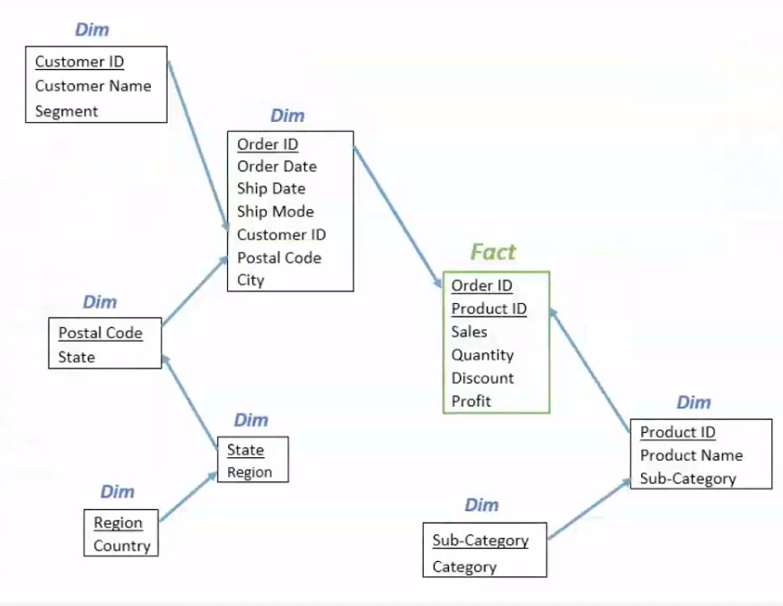
Normalized Tables
"Database normalization is the process of restructuring a relational database in accordance with a series of so-called normal forms in order to reduce data redundancy and improve data integrity.”
This means lots of tables, with most things linked by IDs rather than the actual values
Queries answered by JOINing tables

Slide 17
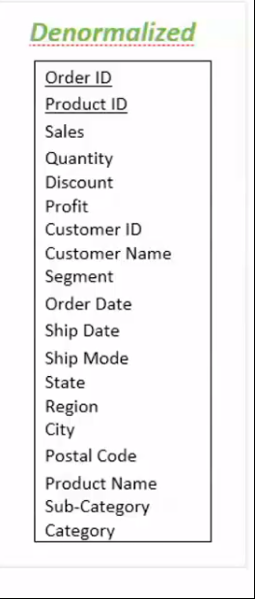
Denormalizing Tables
Notes:
Denormalization at its basic level is simply getting the full result set from the JOINs from the Normalized Tables.
It doesn’t necessarily lead to Row Duplication, but it does lead to storing the same Values in a table over and over, rather than just IDs. This breaks the rules for normalization
If you store denormalized values in a Table, it is very difficult to make updates correctly. This why most Data Warehouses are built on a scheduled ETL process.

Slide 18

Let’s Get Physical
Down at the bottom of every database system is data stored somewhere physically
Row-based systems store all of the values of a row together
When you JOIN tables, the result of the JOIN has to be copied somewhere, either into RAM or temporary DISK storage
When you Materialize a query ahead of time into a table, all of that copying and movement is already done when other queries come in
Notes:
https://upload.wikimedia.org/wikipedia/commons/f/f8/Laptop-hard-drive-exposed.jpg

Slide 19
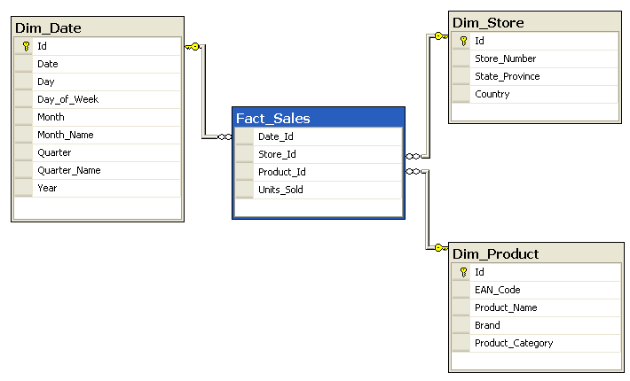
Why Denormalize?
JOINs are EXPENSIVE operations, because of all the logical and physical activity
Denormalizing makes for much faster analytic queries, since all the data is in the table itself
Typical “Data Warehouse” Star Schema denormalizes down to a single Fact Table with JOINs to denormalized Dimension Tables
When a Star Schema is set up correctly, there is no row duplication – the Dimension tables simply add additional columns
Single Table Extract is based on this concept – it queries with ALL the JOINs and gets the full set of Fact rows with all the Dimension columns

Slide 20
Representing Entitlements in a Normalized Model
It is very uncommon for Entitlements to be assigned directly to a user
Sets of Entitlements are typically represented as “Roles”
Ex. Sales Territories:
EMEA-AFRICA-SA-E-I-ENA-1
USCA-CA-CA2-E-F-SNA-2
LAC-MX-MX1-C-I-TER-3
Users are linked to a given role or roles in Many-to-Many mapping table

Slide 21
Normalized Entitlements
AMER-USCA-CA-CA1
Theatre_ID | Theatre_Name
AMER | Americas
Region_ID | Region_Name | Theatre_ID
USCA | USCA | AMER
Sub_Region_ID | Sub_Region_Name | Region_ID
CA | Canada | USCA
District_ID | District_Name | Sub_Region_ID
CA1 | Canada 1 | CA

Slide 22
Denormalized Entitlement View / Table
If Entitlements are stored in Normalized Tables, they should be brought together as a denormalized Entitlement Role View / Table
You may be wondering – how do I connect to the actual users in the Tableau Server?
Role_ID | Theatre_ID | Region_ID | Sub_Region_ID | District_ID
EMEA-AFRICA-SA-E-I-ENA-1 | EMEA | EMEA | AFRICA | SA
USCA-CA-CA2-E-F-SNA-2 | AMER | USCA | CA | CA2
LAC-MX-MX1-C-I-TER-3 | AMER | LAC | MX | MX1

Slide 23
Many-to-Many Mapping Table
Many-to-Many Tables are a technique for linking tables
There can be multiple instances for both Username and the Entitlement attributes
When JOINed to a Fact table without any filters, this causes the “blow up”
Mapping_ID | Username | Role_ID | Company_Role
10001 | d.rector | AMER-USCA-CA-CA1 | Director
10002 | d.rector | AMER-USCA-CA-CA2 | Director
10003 | d.rector | AMER-LAC-MX-MX1 | Director
10004 | a.canadien | AMER-USCA-CA-CA1 | Regional Manager
10005 | a.canadien | AMER-USCA-CA-CA2 | Regional Manager
10006 | j.data | AMER-USCA-CA-CA1 | Account Manager

Slide 24
Models for Mapping Users to Entitlements
There are two primary ways of mapping Users to Entitlements:
Full Mapping to the Deepest Level of Granularity
One row in the mapping table for every entitlement the user has
Requires less JOIN clauses
Sparse Entitlements
A single row in the mapping table for a particular level in the entitlement hierarchy
Vastly reduces the number of entitlement rows for users at high levels in a hierarchy

Slide 25
Sparse Entitlements Table
A Sparse Entitlements table includes entries for every level in a hierarchy, not just the entries for the most granular levels of the hierarchy
NULL values in columns represent having access to ALL of the data
Role_ID | Theatre_ID | Region_ID | Sub_Region_ID | District_ID
ALL | NULL | NULL | NULL | NULL
EMEA | EMEA | EMEA | NULL | NULL
EMEA-AFRICA | EMEA | EMEA | AFRICA | NULL
EMEA-AFRICA-SA | EMEA | EMEA | AFRICA | SA
AMER | AMER | NULL | NULL | NULL
USCA | AMER | USCA | NULL | NULL
USCA-CA | AMER | USCA | CA | NULL
USCA-CA-CA2 | AMER | USCA | CA | CA2

Slide 26
Sparse Many-to-Many Mapping
Deepest Granularity Entitlements Mapping
Mapping_ID | Username | Role_ID | Company_Role
10001 | d.rector | AMER-USCA-CA-CA1 | Director
10002 | d.rector | AMER-USCA-CA-CA2 | Director
10003 | d.rector | AMER-LAC-MX-MX1 | Director
10004 | a.canadien | AMER-USCA-CA-CA1 | Regional Manager
10005 | a.canadien | AMER-USCA-CA-CA2 | Regional Manager
10006 | j.data | AMER-USCA-CA-CA1 | Account Manager
Sparse Entitlements Mapping
Mapping_ID | Username | Role_ID | Company_Role
10001 | d.rector | AMER | Director
10002 | a.canadien | AMER-USCA-CA | Regional Manager
10003 | j.data | AMER-USCA-CA-CA1 | Account Manager

Slide 27
Hands-On: JOINing Entitlement Tables and Mapping Table to make Denormalized View
Notes:
Generic entitlements database already built out that people connect to. Already parsed into tables, users, roles, definitions, get them to join the correct way to show the blown up version of all the entitlements someone has

Slide 28
Step 1: Connect to PostgreSQL database
Open up pgAdmin4 (It will open up a browser window)
In the left Browser pane, right click on Servers and “Create -> Server”
Give whatever Name you want, then go to Connection tag
Host: localhost
Port: 5432
Username: postgres
Password: postgres
Database: entitlements

Slide 29
Step 2: Querying Entitlements Tables
SELECT * FROM theatres;
SELECT * FROM regions;
SELECT * FROM sub_regions;

Slide 30
Step 3: JOINing Entitlements Tables
SELECT
t.theatre_id,
t.theatre_name,
r.region_id,
r.region_name,
s.sub_region_id,
s.sub_region_name
FROM
theatres t
JOIN regions r ON t.theatre_id = r.theatre_id
JOIN sub_regions s ON r.region_id = s.region_id;

Slide 31
Step 4: Create a Synthetic Key
SELECT
t.theatre_id || '-' || r.region_id || '-' || s.sub_region_id AS synthetic_role_id,
t.theatre_id,
t.theatre_name,
r.region_id,
r.region_name,
s.sub_region_id,
s.sub_region_name
FROM
theatres t
JOIN regions r ON t.theatre_id = r.theatre_id
JOIN sub_regions s ON r.region_id = s.region_id;

Slide 32
Step 5: Assign Roles in Mapping Table
SELECT * FROM users_to_role_map;
SELECT * FROM users; -- We use the usernames here in the mapping table
INSERT INTO users_to_role_map VALUES
('bhowell', 'AMER-USCA-SO’),
(‘bhowell’, AMER-USCA-EA’);
UPDATE users_to_role_map
SET role_id='AMER-USCA-WE'
WHERE username='bhowell' AND role_id='AMER-USCA-SO'

Slide 33
Step 5a: Mass Role Assignment
INSERT INTO users_to_role_map
SELECT
u."username",
e.synthetic_role_id
FROM entitlements_denorm_view e
JOIN
(
SELECT username FROM users
WHERE username IN
('ttu','mkannan’)
-- Set your own rules here
) u ON 1=1
-- Set your own rules here too
WHERE e.region_id = 'APAC'
;

Slide 34
Step 6: JOIN Mapping Table to Entitlements Table/View
SELECT * FROM
(SELECT
t.theatre_id,
t.theatre_name,
r.region_id,
r.region_name,
s.sub_region_id,
s.sub_region_name,
t.theatre_id || '-' || r.region_id || '-' || s.sub_region_id AS synthetic_role_id
FROM
theatres t
JOIN regions r ON t.theatre_id = r.theatre_id
JOIN sub_regions s ON r.region_id = s.region_id) a
JOIN users_to_role_map m ON m.role_id = a.synthetic_role_id
This Sub-Query is the Equivalent of a VIEW

Slide 35
“Standard” Row Level Security in Tableau (JOINing Tables)

Slide 36
Live Connections

Slide 37

Row Level Security – High Level Process Flow
All Entitlements
All Data
Filter
On User
Filter On Entitlements
User’s Entitlements
User’s Data
Notes:
https://upload.wikimedia.org/wikipedia/commons/thumb/a/a6/Lil_Wayne_%2823513397583%29.jpg/180px-Lil_Wayne_%2823513397583%29.jpg
To repeat: You are filtering the ENTITLEMENTS on the USER, not the DATA on the User.

Slide 38
Standard Row Level Security
One Database on One Database Server
All Entitlements View
All Data View
WHERE Clause
INNER JOIN
Filter
On User
Filter On Entitlements
User’s Entitlements
User’s Data
Notes:
https://upload.wikimedia.org/wikipedia/commons/thumb/c/c5/Louis_Armstrong_%281955%29.jpg/320px-Louis_Armstrong_%281955%29.jpg
The Calculated Field limits the Rows in the Entitlements table
The Fact Table is INNER JOINed to the Entitlements Table, and is thus limited to those rows linked to the remaining rows in the entitlements
Lil Jon

Slide 39
Filtering and JOINing
Transaction_ID | Product_ID | Theatre_ID | Region_ID | Sub_Region_ID | District_ID
10000001 | FUR-BO-10000112 | AMER | USCA | CA | CA1
10000002 | OFF-LA-10000305 | AMER | USCA | CA | CA2
10000003 | TEC-MA-10000418 | AMER | LAC | MX | MX1
10000004 | TEC-MA-10002210 | AMER | USCA | CA | CA1
10000005 | FUR-TA-10001950 | AMER | LAC | RoLAC | CR
10000006 | OFF-AR-10003478 | AMER | USCA | CA | CA1
WHERE username = ‘acanadien’
Username | Role_ID | Theatre_ID | Region_ID | Sub_Region_ID | District_ID
lsmith | AMER-USCA-CA-CA1 | AMER | USCA | CA | CA1
lsmith | AMER-USCA-CA-CA2 | AMER | USCA | CA | CA2
lsmith | AMER-LAC-MX-MX1 | AMER | LAC | MX | MX1
acanadien | AMER-USCA-CA-CA1 | AMER | USCA | CA | CA1
acanadien | AMER-USCA-CA-CA2 | AMER | USCA | CA | CA2
jdata | AMER-USCA-CA-CA1 | AMER | USCA | CA | CA1
JOIN ON Theatre_ID, Region_ID, Sub_Region_ID, District_ID

Slide 40
Compound Keys vs. Synthetic / Surrogate Keys
A Compound Key is the combination of multiple columns that define a unique Key. The previous example with multiple JOINs uses Compound Keys
One way to improve performance is to create a “Synthetic” Key, which identifies the entitlement. It doesn’t necessarily have to resemble columns themselves
Ex.
Role_ID = Theatre_ID + Region_ID + Sub_Region_ID + District_ID
or
Role_ID = 18203982180110
To improve performance, you could add the “Synthetic Key” to the Fact table and then the JOIN is only seeking on ONE column.

Slide 41
How It is Supposed to Work
The denormalized Entitlements View gets filtered first just to the USERNAME
Even though this view may be “blown up” and very large, it should reduce down just to that user’s particular entitlements
The resulting rows then limit the results of the Data View through the INNER JOIN
All JOIN columns in both tables need have INDEXES, and also possibly have a Primary Key – Foreign Key relationship

Slide 42
When it all blows up
Ideal Database Processing:
Filter Entitlements on User
JOIN that filtered set of Entitlements to the Fact Table
Max Number of Rows = Rows in Data Table (No Fact Row Duplication)
“Blowing Up” happens when database processes the query in this order:
JOIN all of the Entitlement Rows to the Fact Table
Max Possible Size = Number of Entitled Users * Rows in Fact Table (Maximum Duplication)
Filters down to user’s rows
We call this a “blow up” (like a balloon) because the total volume expands exponentially, but also because your systems will break like they exploded
This is true for Live Connections, but also for Extracts

Slide 43
Options for Live Standard Row Level Security
Options when Connecting Live:
JOINing Tables in Tableau
Database Filtered Views
Impersonation / Run As
Initial SQL
All of these use the same database “mechanism” of Standard Row Level Security:
JOINing the Entitlements View to the Data View
Filtering the Entitlements View by the User

Slide 44
Security View JOINs in Tableau
Use: When Tableau users aren’t necessarily users of the database, but their Entitlements still exist in the database in tables
1. Create Entitlements View and JOIN to the Data Table/View
2. Create a RLS Calculated Field and make it a Data Source Filter
Notes:
At Tableau, every person is a Database User on ALPO
But in Tableau’s Salesforce instance, we are not Users of the Salesforce Database, we just exist as rows in the database listing what user belong

Slide 45
Hands-On: JOINing and Filtering Data Table and Entitlements View
Notes:
We built out a nice entitlements view before, so let’s use it to filter our data now. Open up Tableau 2018.3 or LATER, and JOIN the entitlements_map_view to superstore_global_facts

Slide 46
Databases with Impersonation (SQL Server)
Some sources, such as MS SQL Server, allow Impersonate (EXECUTE AS)
Requirements:
All Tableau users must exist in the database server as users with SELECT rights for the Views
Either Run As user of Tableau Server or the user with saved credentials has the permission to EXECUTE AS for all of the Tableau users who are in the database
The DBA must have configured views which filter based on the Database User
Notes:
Essential: The DBA MUST set up the database to make this possible. It doesn’t ”just happen” because you use RUN AS or Impersonate. If they don’t have it built out already, it may be more work than just doing it all in Tableau. In particular, you need ALL of the users to be in the database as Database Users.

Slide 47
Databases that use Initial SQL for User Views
Some databases, particularly Oracle using VPD, can use Initial SQL to force a session to show views just for that user
Initial SQL runs a particular Stored Procedure / Function to set the Context of that database connection to match the Tableau user’s username
Just like Impersonation, DBA must set up VPD and all of the associated Users and the querying rules
Notes:
This is actually why they built Initial SQL in the first place! Also, anecdotally we’ve heard that VPD is typically very slow but I don’t think that’s Tableau’s problem necessarily.

Slide 48
Setting up SQL Server for Impersonation
Notes:
Let’s talk about what the DBA actually sets up in SQL Server to make this all work. From there, we can generalize on how to do this in Tableau itself.

Slide 49
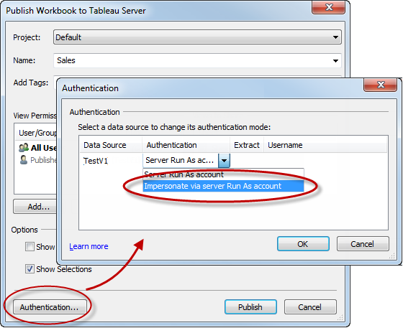
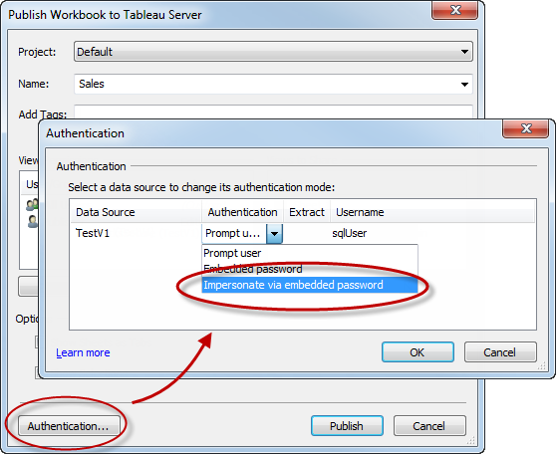
SQL Impersonation requires Impersonate Permission
SQL Impersonation can work using either:
The Run As User of the Tableau Server
OR
The Publisher of a Data Source
The User must have the Impersonate permission
allowed on SQL Server

Slide 50
How does Impersonate User Actually Work?
Let’s simulate in Tableau what happens inside SQL Server when Impersonate User is working correctly
A Table that has the Logged In User (e.g. a Custom SQL query that is: SELECT SYSTEM_USER AS 'Login Name‘)

Slide 51
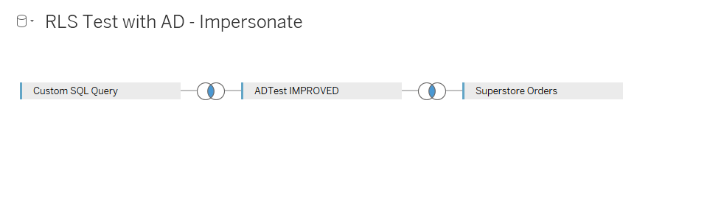

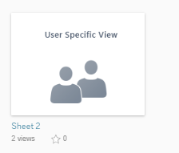





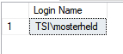

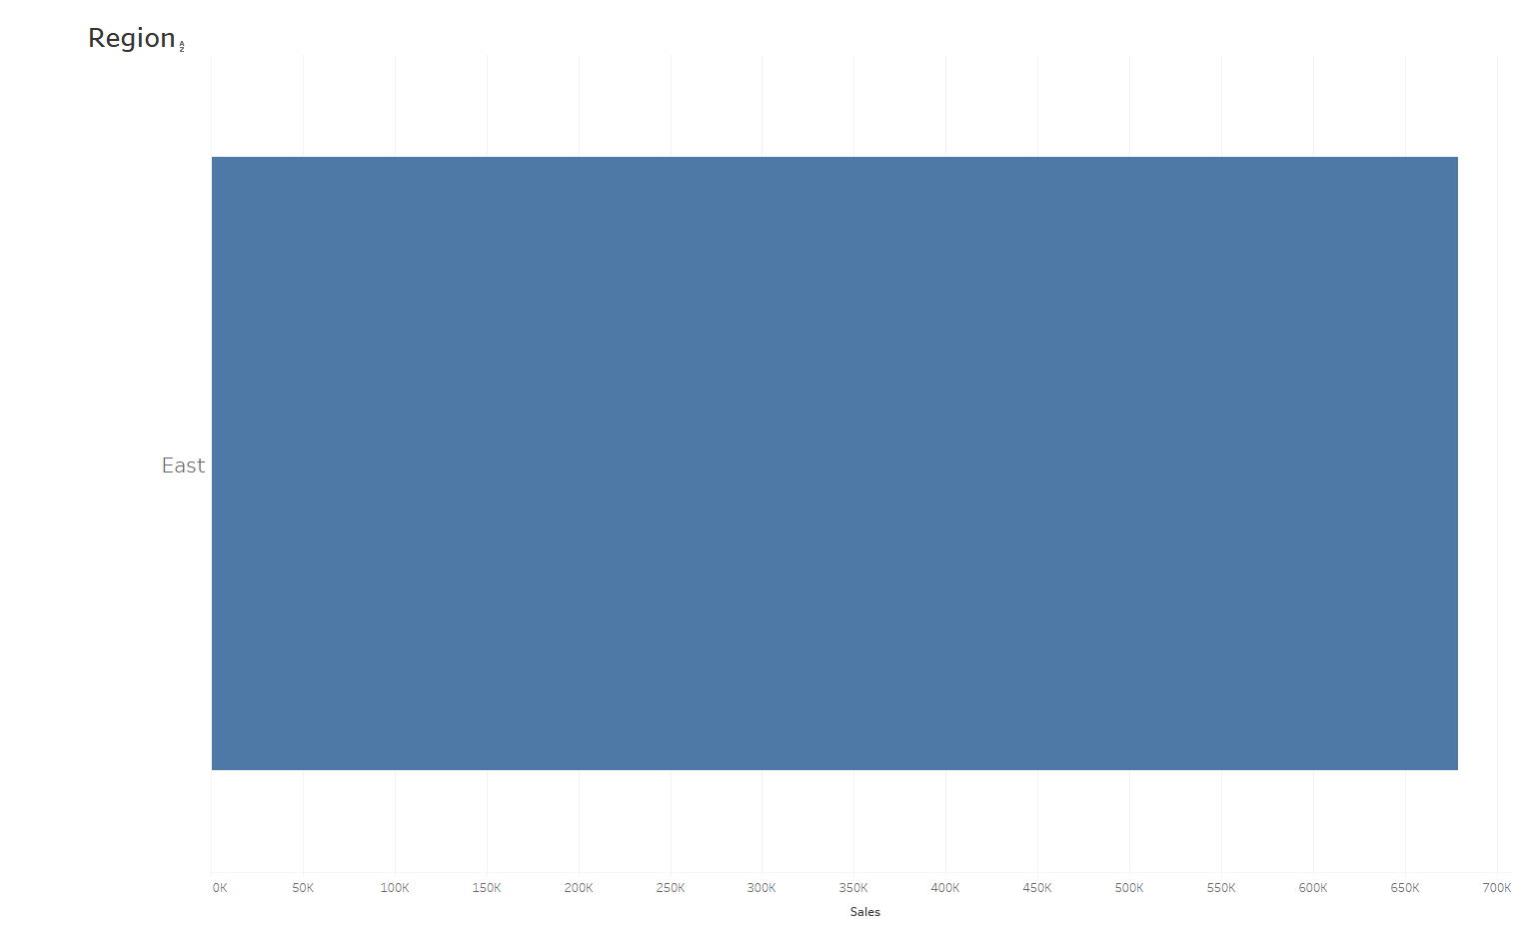
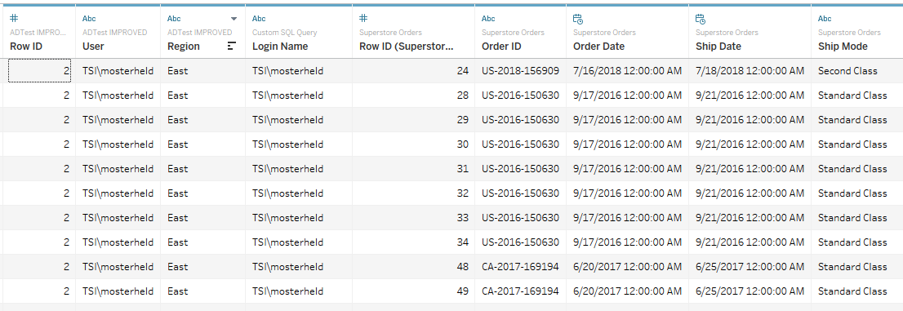
Impersonate via Run As User/Embedded Credentials
This could all just be materialized as a View as well…
SELECT SYSTEM_USER AS 'Login Name‘
Would give you TSI\mosterheld
Run-As User pretends to be mosterheld
Which results in:
I’m TSI\mosterheld!

Slide 52
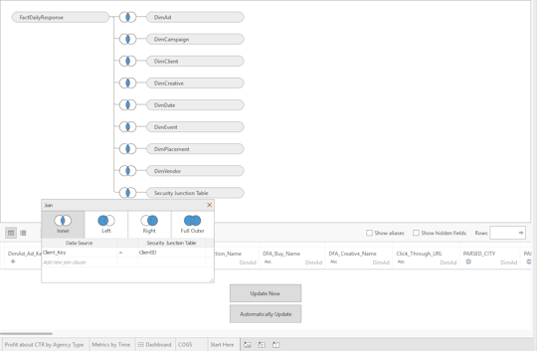
Security Junction Table (SQL Server 2016)
Notes:
https://tableaulove.com/using-sql-server-2016-to-accelerate-row-level/
https://docs.microsoft.com/en-us/sql/relational-databases/security/row-level-security?view=sql-server-2017

Slide 53
Security Junction Table (SQL Server 2016)
Essentially, this just pushes exactly what we normally do by joining in an entitlements to the database
What you need:
A “Security Junction Table” which essentially has all the stuff (client ids, stores, regions) that a particular user can see. It’s an entitlements table.
A “Table Valued Function” (TVF) that returns true/false whether the person executing the query is the same as the person in the username column of the Security Junction Table
A security policy which binds the two together, with State = ON
The Security Junction Table Joined in to the datasource in the Tableau UI
“Impersonate via Run as User” embedded in the connection
Notes:
https://tableaulove.com/using-sql-server-2016-to-accelerate-row-level/
https://docs.microsoft.com/en-us/sql/relational-databases/security/row-level-security?view=sql-server-2017

Slide 54
Extracts

Slide 55
History of Contains Method/Extracts
Before Multi-Table Extracts, whenever you took an extract of tables with one-to-many or many-to-many relationship, the extract would “blow up”
The query that generates the Extract includes all JOINs. This results in:
A huge load on the underlying database as it generated the result set of the two tables as the rows multiplied
Vastly more rows transferred across the wire to Tableau
A very long process while the TDE or Hyper engine sorted, processed and reduced the blown up result into a columnar form

Slide 56
Single-Table Extracts w/ Entitlements “Blow Up”
Username | Theatre_ID | Region_ID | Sub_Region_ID | District_ID
lsmith | AMER | USCA | CA | CA1
lsmith | AMER | USCA | CA | CA2
lsmith | AMER | LAC | MX | MX1
acanadien | AMER | USCA | CA | CA1
acanadien | AMER | USCA | CA | CA2
jdata | AMER | USCA | CA | CA1
Transaction_ID | Product_ID | Theatre_ID | Region_ID | Sub_Region_ID | District_ID
10001 | FUR-BO-10000112 | AMER | USCA | CA | CA1
Total Rows = # Entitled Users for Row * Row Count
Username | Theatre_ID | Region_ID | Sub_Region_ID | District_ID | Transaction_ID | Product_ID | Theatre_ID | Region_ID | Sub_Region_ID | District_ID
lsmith | AMER | USCA | CA | CA1 | 10001 | FUR-BO-10000112 | AMER | USCA | CA | CA1
acanadien | AMER | USCA | CA | CA1 | 10001 | FUR-BO-10000112 | AMER | USCA | CA | CA1
jdata | AMER | USCA | CA | CA1 | 10001 | FUR-BO-10000112 | AMER | USCA | CA | CA1
Notes:
Prior to having multi-table extracts, having a fully blown-up entitlements table would cause the fact table to blow up too, generating a monster size extract.

Slide 57
The Contains Method for Row Level Security
The “Contains Method” refers to the remarkably efficient CONTAINS() function
By placing all possible usernames in a single column like:
bhowell|mosterheld|rdugger|…
you can do:
CONTAINS([Username Column], USERNAME())

Slide 58
Issues with the Contains Method
How do you even go from your entitlements in rows to a single column separated correctly using SQL?
Partial matches in strings can be trouble
Brad Howe -> bhowe. Bryant Howell -> bhowell. CONTAINS(‘bhowell’, ‘bhowe’) returns TRUE
You actually need a separator that is included in the search, but will never be valid in the IDs themselves. For example:
CONTAINS([Column], “|” + USERNAME() + “|”
A column can only contain so many characters. Adding the separators which are necessary reduces the total potential you can store
This technique is very slow for most databases, so it isn’t useful on Live Connections

Slide 59
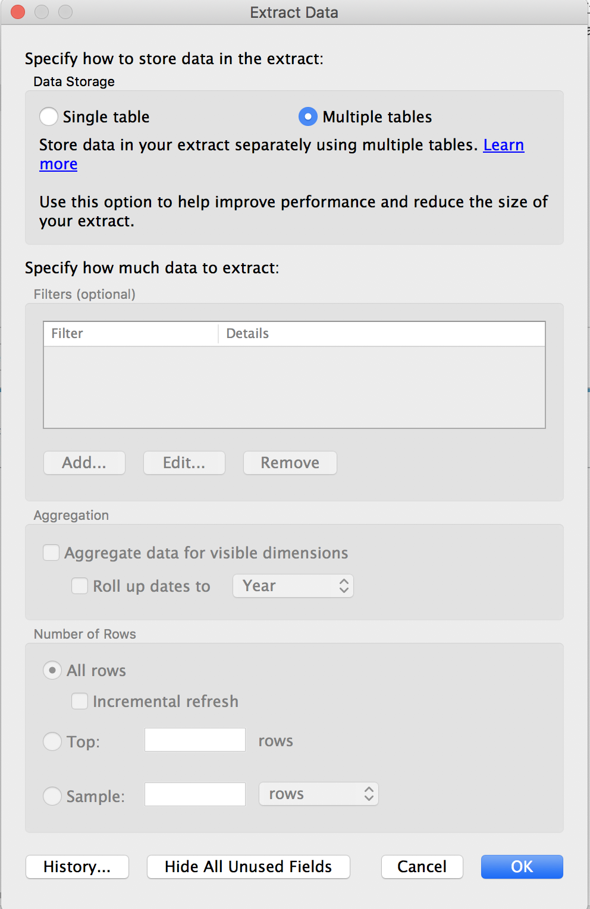
Use Multiple Table Extracts!
Starting in 2018.3, you can take an extract with the “Multiple Tables” option
Built specifically for Standard Row Level Security
Design everything exactly like you would for a live connection

Slide 60
Caveats with Multi-Table Extracts
Only in Tableau 2018.3 or Later!
No Filters Use Views or Custom SQL to limit data sets
No Incremental Extracts
No Aggregated extracts

Slide 61
Hands-On: Extracts and Normalized Tables
Notes:
Now take an extract of those two tables. What if want to put a filter on while doing Multi-Table?

Slide 62
Non-JOIN Database Techniques

Slide 63
Query Optimizer and Performance
A SQL query only describes the RESULTS you want, not how to actually retrieve them
For a given query, there may be many possible ways for the database to answer the question
When the query is received, the Query Optimizer in the RDBMS tries to figure out the most efficient way to answer the given query
In general:
The simpler the query, the less effort to determine the best Query Plan

Slide 64
Direct WHERE Clauses
Rather than JOINing a table of entitlements, if you have the entitlements values, you could just put them into a WHERE clause
FROM fact_table f
WHERE f.[Theatre_Id] IN (‘AMER’)
AND f.[Region_Id] IN (‘USCA’)
AND f.[Sub_Region_Id] IN (‘CA’)
AND f.[District_Id] IN (‘CA1’, ‘CA2’)
If the set of possible entitlements per user is small, this an be very efficient at the database level
If you have created synthetic keys on the FACT table, you are filtering directly without any JOINs: Super Fast!
Notes:
If this is possible, why don’t we do it?

Slide 65
Custom SQL
You can put specific WHERE clauses directly using Custom SQL
Custom SQL can incorporate Tableau Parameters
This is not an ideal solution because:
Tableau Parameters are not secure without a lot of effort
Parameters can only take a single value

Slide 66
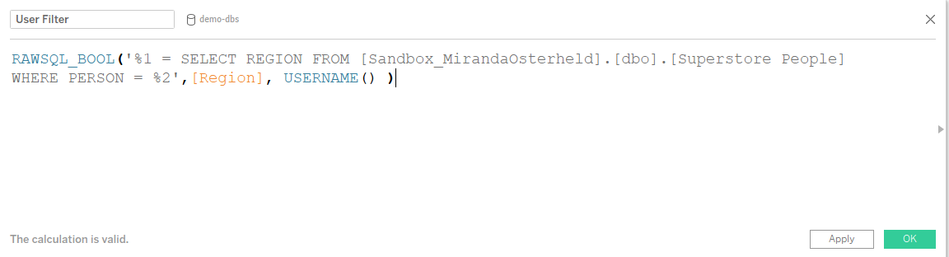
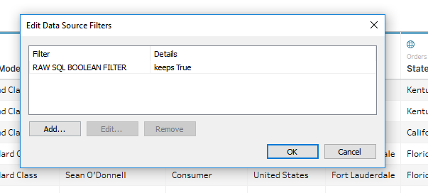
RAWSQL to write direct SQL statement taking Username() as input
The RAWSQL command allows you to put a direct WHERE clause and use the USERNAME() function (as well as Parameters)
Notes:
Requirements: A. Username and mapped entitlements exist as a table in database
RAWSQL calculated field taking in username function on the filters shelf.
How it works: RAWSQL_BOOL gets put on the filter shelf, database is looking up the appropriate values for the username from some other table, and only returning the values to filter the “column”.

Slide 67
Why do people even use Stored Procedures?
Remember the Query Optimizer we talked about?
A Stored Procedure stores the Query Plan for a given query
Anything that might vary between the query becomes a Parameter
When a Stored Procedure is run, it skips the Query Planner altogether and just runs the Query Plan
Beyond this, Stored Procedures can do much more than a plain query:
Multiple queries feeding into one another
Procedural Programming: Iteration, IF THEN clauses, etc.
Notes:
But really they just use them to TORMENT TABLEAU

Slide 68
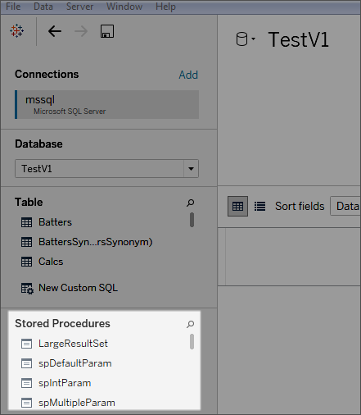


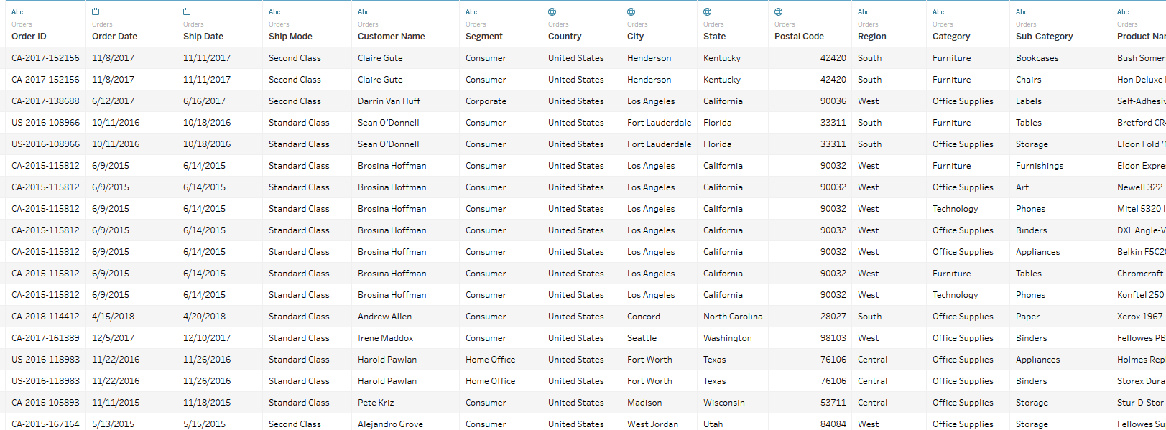

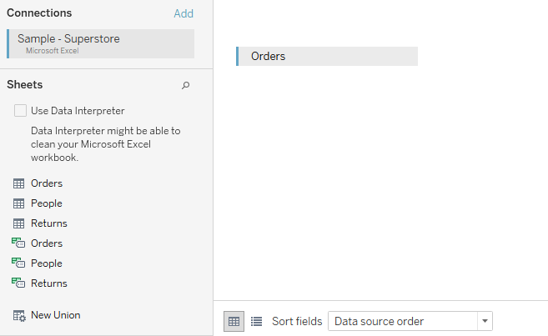
Stored Procedures: Two Major Ways We Work With Them
SP returns the actual data:
As a datasource:
1.
Parameters in:
Username, token,
Etc.
SP resolves the Security Context:
SP returns the criteria for what they should see
2.
WEST
EAST
Parameters in:
Username, token,
Etc.
WEST
CUSTOMER A IN COMPANY B
(connecting to normal tables as your datasource)

Slide 69
Stored Procedure Decision Matrix
 | Data Source | Security Context
Username | Initial SQL | RAWSQL
Token | JS API or URL Parameter to Set, Decryption in the SP | RAWSQL to Set, Decryption in the SP

Slide 70

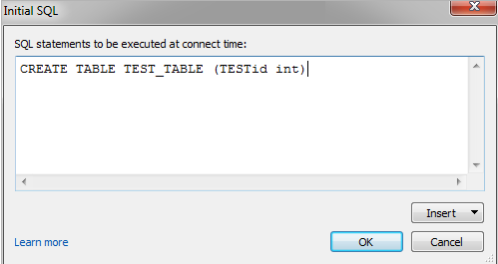




Stored Procs as Data Source: Passing Username
Can’t just pass username through a Tableau Parameter because that can be easily changed via the URL and there goes all your security (but see later…)
Initial SQL can pass the USERNAME but requires effort
username
Data that user can see
1.
DECLARE @query as nvarchar(300) = 'SELECT [Current SPID] FROM [Tableau Sessions] WHERE [Current SPID] = @@SPID'
EXECUTE sp_executesql @query
IF @@rowcount = 0
BEGIN
INSERT INTO [Tableau Sessions] VALUES ([TableauServerUser], @@SPID)
END
ELSE
BEGIN
UPDATE [Tableau Sessions]
SET username = [TableauServerUser]
WHERE [Current SPID] = @@SPID
END
SP INCEPTION!
Joe Schmo’s
Data!
Update!
My Tableau Sessions
Who’s logged in?
USERNAME | SPID
mosterheld | 53
3.
2.
Notes:
Connecting to the SP as a datasource – the SP is returning all the data for that specific user
What you need:
Table in our SQL Server for your Tableau based SPID (current user) sessions; You only need two columns: [Username] nvarchar(n) and [Current SPID] int
Stored procedure that can return data specific to a user based on their username.
How it works:
Run Initial SQL that updates the SPID sessions with the current logged in users
Then in any view or stored procedure you use as your datasource, lookup the logged in user in that table by the session ID and then have the SP return the rows that person can see (within the database).
How it works: Initial SQL commands are run before any queries within a particular Tableau Server user’s session. The Initial sql calls its own stored procedure/function that updates The "tableau sessions" table, which gives you a mapping of SPID -> username. Then in any view or stored procedure you use as your datasource, lookup the logged in user in that table by the session ID and then have the SP return the rows that person can see (within the database).
Good for: Oracle VPD and Microsoft SQL Server

Slide 71





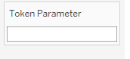
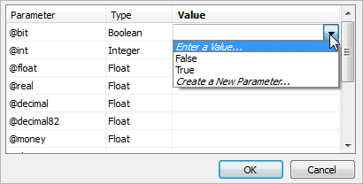


Stored Procs as Data Source: Passing a Token
We can pass a token through a Tableau Parameter if it’s not something like SchmoJoeWest123 – should be passed encrypted so that we mitigate risk of setting parameters via the URL
We need a Tableau Parameter that is used to pass the token to the SP
Asdljh320942liksadjf
Data that user can see
1.
Application sets the Tableau parameter
as the encrypted token, which is tied to a parameter on the SP side.
2.
Joe Schmo
(982374023) ’s
Data!
3.
Asdljh320942liksadjf
982374023
Joe Schmo!
Notes:
Connect to an SP that receives a user-specific encrypted token through a tableau parameter and returns the data that user can see
What you need:
A. Stored procedure that can return data specific to a user based on their token (must be able to decode token)
Token has to be encoded in some way, since you can set parameters via URL
B. Tableau parameter to pass the token to the SP datasource.

Slide 72
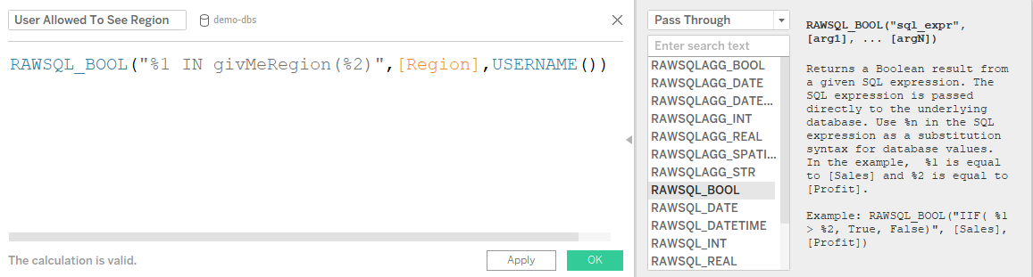



Stored Procs for Security Context: Passing Username
1.
Connect to tables normally
WEST
username
2.
Write your RAWSQL pass-thru calc to call the SP
This calc is essentially saying “T/F: this region in the list of regions this person has access to? (the list is given by the SP)
A Boolean calc we can put on the filters shelf
3.
WEST
givMeRegion is an SP the returns
a list of regions that person has access to
Joeschmo
Notes:
Requirements: A. Stored procedure to resolve the security context taking username as input that returns back , for example, the list of regions or stores or whatever that person should see
B. Raw SQL Bool function calling that stored procedure on the filters shelf, then set to true

Slide 73







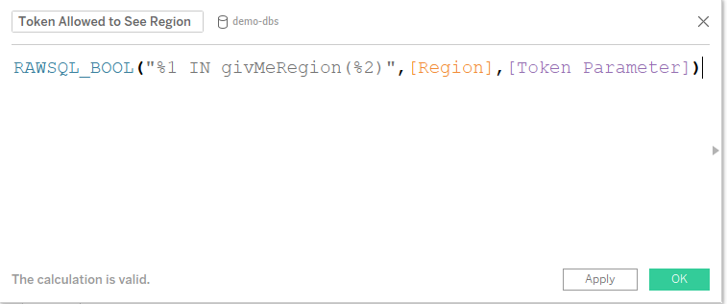



Stored Procs for the Security Context: Passing a Token
WEST
1.
Connect to tables normally
Asdljh320942liksadjf
2.
Application sets the Tableau parameter
as the encrypted token
3.
Write your RAWSQL pass-thru calc to call the SP
This calc is essentially saying “T/F: this region in the list of regions this token has access to?” (the list is given by the SP)
4.
Data source filter
WEST
Asdljh320942liksadjf
givMeRegion is an SP the returns
a list of regions that the token has access to
Notes:
Requirements: A) Web application creates the parameter token. The parameter is correctly encoded from the sending web application
B) There SP/function in the database that can decode it and returns back the correct security contex
C) Tableau Paremeter is set up to have it's value set to the token value via the Javascript API
D) The RAWSQL Bool function takes in the tableau parameter, decrypts it, and returns a vlue of true or false for whether that token has access to that row of data
Authentication and authorization come from another service which generates auth tokens, which include entitlement information through along with the user .Pass the token in as a Tableau Parameter, then have it decryped amd interpreted by a function using RAWSQL

Slide 74
Hands-On: RAWSQL

Slide 75
Step 1: Connect just to the Superstore fact table in Tableau
RAWSQL methods do not require JOINing tables together, so just JOIN to the fact table / view

Slide 76
Step 2: Create a Test Parameter
In the real world, you will use the USERNAME() function to securely pass the username into the Calculated Field
For this example, create a String parameter called [Username Test Param]

Slide 77
Step 3: Create this Calculated Field
RAWSQL_BOOL(
'region IN (
SELECT sub_region_name
FROM users_entitlements_roles_view
WHERE username = %1) ‘,
[Username Test Param]
)

Slide 78
Step 4: Alternative Calculated Field Calling a Function
RAWSQL_BOOL(
'region IN (
SELECT security_role('sub_region_name', %1))
‘,
[Username Test Param]
)

Slide 79
Securely Filtering at Report Load Time using Parameters

Slide 80
Filtering at Report Load Time

Slide 81

Entitlements From Application Layer
Database
Application Layer
All Entitlements
All Data View
Tableau Viz URL
WHERE Clause
Filter
On User
Filter On Entitlements
User’s Entitlements
User’s Data
Notes:
Lil Xan

Slide 82
Filters vs. Tableau Parameters
Filter: Sets the value(s) for a particular Dimension or Measure
Creates a WHERE clause in the SQL
Tableau Parameter: Storage for a single value
Can be used in a Calculated Field
Calculated Fields become Dimensions that can be used as Filters
URL Parameter: Anything after the ? in a URL
?Something=Value
Can set the Value of a Filter or a Tableau Parameter

Slide 83
Setting Filter Values at Report Load Time
Filters and Tableau Parameters can be set using URL Parameters or JS API
Example of Setting Values using URL Parameters:
MyWorkbook/MyViz?Category=Furniture,Office Supplies&Username=bhowell
User can clear or reset Filters or Tableau Parameters via URL or JavaScript API
NOT SECURE
Notes:
Tableau Server does not have a “per view” type of Single Sign-On. All SSO methods create a session of some sort, after which any view which the user has Permissions to see can be loaded
Allows for reloading with new URL Parameters, or your own JS API scripts
Filters can be cleared using two very simple JS API commands
Parameters can be reset to anything (or null) using JS API

Slide 84
Securely Filtering with Tableau Parameters
Tableau Parameter values can be set to any value or null by end user
Calculated Fields can have logic to validate and protect against ”error cases”
IF LEN([Our Parameter]) == 20 THEN
IF [Our Parameter] = [Some Field] THEN 1
ELSE 0
END
ELSEIF ISNULL([Our Parameter]) THEN 0
ELSE 0
END
Notes:
This must be a data source filter, as we mentioned at the beginning.
Creating a Data Source Filter on this type of Calculated Field creates a Filter that cannot be removed or altered
Only the value of the Parameter can be reset

Slide 85
URL Parameters are an attack vector
WARNING: URL Parameters passed in the clear are not secure because the End User can change the values
Ex.
MyWorkbook/MySheet?username=rdugger&region=South
Remember, the end user can see the URL and try to send other variations
Easy to see what the parameters stand for
Easy to see the pattern of the values
Easy to try obvious combinations

Slide 86
Securing the URL Parameters
Goal: Obfuscate / Encrypt both parameter names and values
In the Clear
MyWorkbook/MySheet?username=rdugger&region=South
Obfuscated/Encrypted
MyWorkbook/MySheet?p1=832h9hn9f8h234h943hr983&p2=234829482bksdfh348hr34j

Slide 87
Securing the Tableau Parameter Values
Parameter Values must be hashed / encrypted / encoded following the principle:
If you know both encoded and real values, you still cannot generate the encoded value for any other real value.
Options:
Hash Values with Shared Salt
Encrypt Values with Shared Key
Use non-sequential alphanumeric IDs
Real Value | Encoded Value
South | 234829482bksdfh348hr34j
North | ???
Notes:
Using an hashing/encryption algorithm that is known to be safe, such as AES or SHA-256

Slide 88
Calculated Field to Filter on Multiple Parameters
Parameters can only store one value at a time
To filter inclusively on multiple parameter values on the same field, you can use a CASE statement
CASE [Database Field]
WHEN [Parameter 1] THEN 1
WHEN [Parameter 2] THEN 1
WHEN [Parameter 3] THEN 1
...
ELSE 0
END
CASE [f1]
WHEN [p1] THEN 1
WHEN [p2] THEN 1
WHEN [p3] THEN 1
...
ELSE 0
END

Slide 89
Best Practice for Large User Counts
Even if you have too many users to add every username into Tableau, you should at minimum create a user at the “tenant” / “customer” / “organization” level
Best Practice for this scenario involves two levels of security filtering:
USERNAME() function to filter at the “Tenant” level
URL Parameters for additional levels of filtering

Slide 90
Best Practice Example
Ex. “Tenant” is a Customer with a unique ID:
IF USERNAME() == [Customer ID] THEN
CASE [Some Field]
WHEN [p1] THEN 1
WHEN [p2] THEN 1
WHEN [p3] THEN 1
…
ELSE 0
END
ELSEIF ISNULL([p1]) THEN 0
ELSE 0
END

Slide 91
Web Services / REST API Datasources

Slide 92
Web Services / REST API “Live” Connection
Many organizations have highly optimized Web Services / REST APIs to access data
The requirements for connecting to these Web Services typically are:
Communication over HTTPS
Receiving responses in JSON/XML
Passing parameters and/or authentication tokens, most often through POST method, for each user or report that is loaded
Web Services responses often aren’t tabular
Need to be transformed to Rows and Columns for Tableau to do analysis

Slide 93
Standard Solutions for Web Services Data (and why they don’t scale)
JSON Connector
Only connects to local files on a file system
Web Data Connector
Useful for Desktop, but not for Server
Creates an Extract which only refreshes on a schedule
Can store one set of user credentials (that of the publisher)

Slide 94
What does a Web Data Connector do really?
Tableau expects data be in a relational format
Steps:
Retrieve Web Service Data
Transform response from Object form to Rows of Data
Create the Schema for the Extract table(s)
Insert the rows of data in Tableau Extract (Hyper, previously TDE)
Retrieving response and transforming to rows of tabular data requires the effort

Slide 95
Storing Web Service Responses in an RDBMS

Slide 96
Using a Relational Database to Store Web Service Responses
Remember: The majority of the work is retrieving the web service responses and transforming it to a tabular format
Web Data Connector inserts transformed rows into an Extract file
Relational Databases are very good at inserting large numbers of rows
Solution: Store the web service responses in an RDBMS table and connect Tableau to that table

Slide 97
RDBMS Storing Web Service Responses: Embedded Application
Web Application Page
6. Load Tableau Viz using JS API, with Response ID Parameter set to Response ID
Tableau Workbook
5. Retrieve Response ID
Send Authentication
Info (Token, Attributes, etc).
Your Code:
Retrieve, Transform, Insert
7. Live Connection to Response Table,
Data Source Filter on [Response ID Column] = [Response ID Parameter]
2. Send Request for
Data including Auth Info
4. Write tabular data to Response Table with
Response ID in every row of a Column
3.Retrieve Object
Response
Response DB
Data Web Service
Notes:
Solution
Write Web Service responses to a permanent Table in a Relational Database, with a unique Data Session Identifier for that particular web service request
Pass Data Session Identifier to Tableau workbook connected to the Table to use as a Data Source Filter
Clean up the Table on a regular basis to clear out old results

Slide 98
Example Response Table
Should store Response ID as an INDEXed field
Store timestamp to allow cleaning up out-of-date responses
Response ID | Timestamp | Field 1 | Field 2 | Field 3 | Field 4 | Field 5 | Field 6
jxX32jC309xc0489bmujZXUxZ | 2018-10-21 10:21:12
jxX32jC309xc0489bmujZXUxZ | 2018-10-21 10:21:12
jxX32jC309xc0489bmujZXUxZ | 2018-10-21 10:21:12
G0Fj3xV39320v038X0389lzBe | 2018-10-21 14:42:52
G0Fj3xV39320v038X0389lzBe | 2018-10-21 14:42:52
a0X538xc2z33420oT4UzxXLuU | 2018-10-21 14:44:32

Slide 99
Filtering on Response ID in Tableau
Response should be a long unique randomly generated string
INDEX the columns storing the Response ID in the DB
The Tableau Parameter name to receive this value can be short
p1, s1, etc.
Create a Calculated Field to filter to the Parameter value
[Response ID] = [p1]
Create a Data Source Filter on the Calculated Field
Notes:
20 characters+ should be sufficient to avoid collisions
The column names can be obfuscated or not; the identifier is random and unconnected to any part of the request itself

Slide 100
Assumptions for Storing Web Service Responses in Database Table
Web Service responses must be a reasonable size and return fast
Each Web Service Endpoint / Response type will require its own Table to be defined in the Relational Database
Tableau workbooks are Embedded in an Application which handles the web service and the database insertions
Notes:
Can only load into the database as fast as the response comes back
The more data loaded at each time, the longer the lag before Tableau can access the data
If set up properly, JOINs will still be possible. Requests to multiple endpoints can be stored with the same “Data Session Identifier”
This mechanism assumes another web application which handles the authorization and web service requests
The code that converts the web service response into a relational row and stores it in the database can be “part of” the application or a separate service/process

Slide 101
What about non-embedded use cases?
So far we’ve considered situations where there is an external application able to call this extra code to load the Web Services response into a Database
The Tableau Extensions API allows integrating additional web-based components into a standard Tableau Dashboard
The code which does the Request->Convert->Load process moves into the Extension

Slide 102
RDBMS Storing Web Service Responses: Extension in Dashboard
Tableau Workbook
Tableau Extension
6. Load Tableau Viz using JS API, with Response ID Parameter set to Response ID
0. Sign-In
5. Retrieve Response ID
Send Authentication
Info (Token, Attributes, etc).
Your Code:
Retrieve, Transform, Insert
7. Live Connection to Response Table,
Data Source Filter on [Response ID Column] = [Response ID Parameter]
SSO / Auth
2. Send Request for
Data including Auth Info
4. Write tabular data to Response Table with
Response ID in every row of a Column
3.Retrieve Object
Response
Response DB
Data Web Service
Notes:
Solution
Write Web Service responses to a permanent Table in a Relational Database, with a unique Data Session Identifier for that particular web service request
Pass Data Session Identifier to Tableau workbook connected to the Table to use as a Data Source Filter
Clean up the Table on a regular basis to clear out old results

Slide 103
Flexible On-Demand Extracts

Slide 104
Flexible On-Demand Extracts with Extract API
Move the ”selection logic” of a Web Data Connector into the Embedded Application
Store the selection options as “Extract Recipes”
Incorporate Scheduler or On-Demand Running of “Extract Recipe”
Create the Extracts per the ”recipe” and publish to Tableau Server

Slide 105
Use Case for Extract API
Large amounts of data (rows or columns), with many different options
Two step process:
Decide on Data Set Definition
Create report on data set (Web Edit)
If you want to connect generated Extracts to Report Templates, must restrict the options provided in Extract Definition

Slide 106
Extract API
Can generate an Extract on demand if incorporated into its own service
Can append to existing Extract
Good for creating Extracts of large data sets which will remain relatively static and long-lived
”Locking Issue”: If multiple users request data at the same time, must queue those requests so that they are all added to the updated Extract before it is published

Slide 107
Extract Generator Workflow – New Extract for Web Edit
5. Scheduler informed of newly queued
extract
Scheduler Process
Web Page for Extract Definition
Extract API Generation Code
6. Extract definition grabbed from queue
2. Save ”Recipe”
7. Extract File Created
6.
1. Select options and press save
8. REST API Publish
4. Saving Complete
Recipe and Scheduler
DB
10. Status of Extract Updated
3. Extract Definition pushed to DB, added to schedule queue
9. Extract File Uploaded
User
Tableau Server

Slide 108
Conclusion

Slide 109
START
Are you using Extracts?
Pre- or post-2018.3?
Post-
Y
Multi-Table Extracts
Pre-
N
Contains Method
Do you have a MSSQL Server or Oracle Database VPD with user level security already set up?
N
N
Standard RLS using User Filters with Entitlements Table
Do you have any RLS set up somewhere?
Y
Impersonate with
Run As User/Embedded Credentials
Initial SQL for Oracle VPD
Y
Entitlements Table
What is it?
Stored Procedure
What does the SP return?
Entitlements from separate application
security context
What do you need to do?
data
What is the input?
token
RAWSQL + Decryption
Filter the Viz at load time with entitlements provided by app
Connect to REST API/Web Services data that has the security built in
Store webservice responses in RDMS
What is the input?
token
username
username
Decryption + JS API*
JS API to set tableau parameters with obfuscated/encrypted values
Initial SQL
RAWSQL
Notes:
Works the same way as the link, except the stored procedure isn’t in the RAWSQL calculation, the stored proc is the datasource, and you use the javascript API to set the parameter dynamically.

Slide 110
Thank You!

Slide 111

We need your data!
Click “Evaluate” in the app menu !

Slide 112
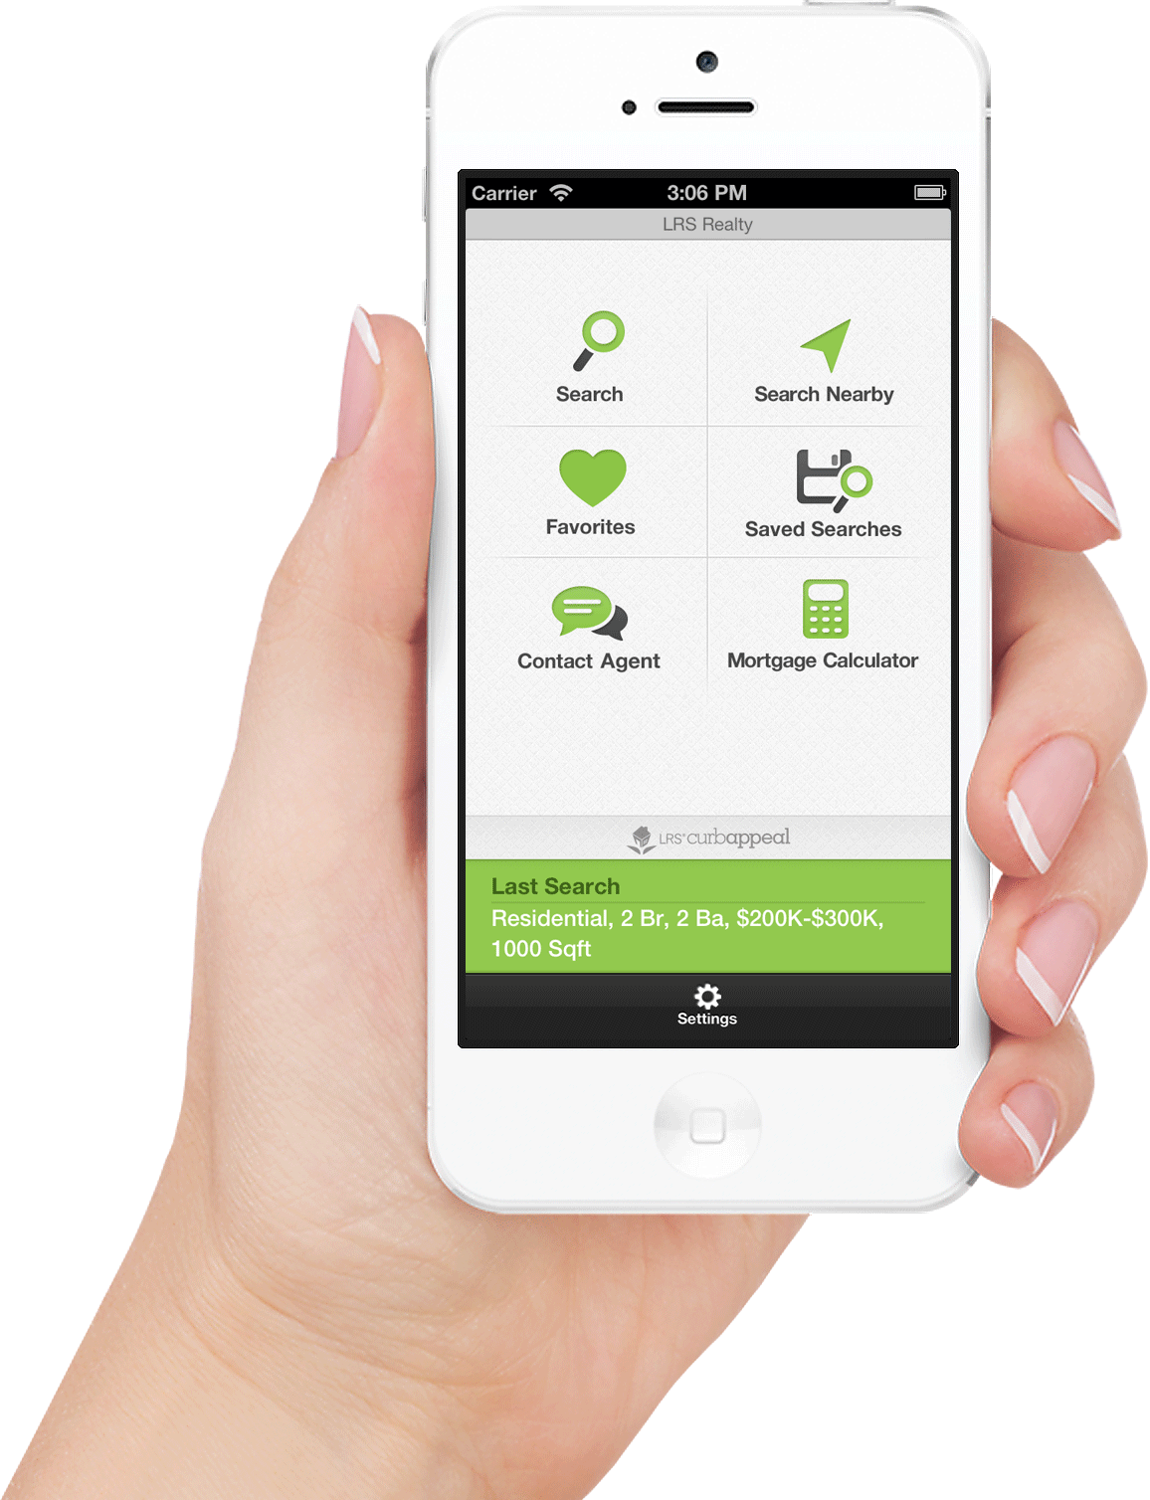
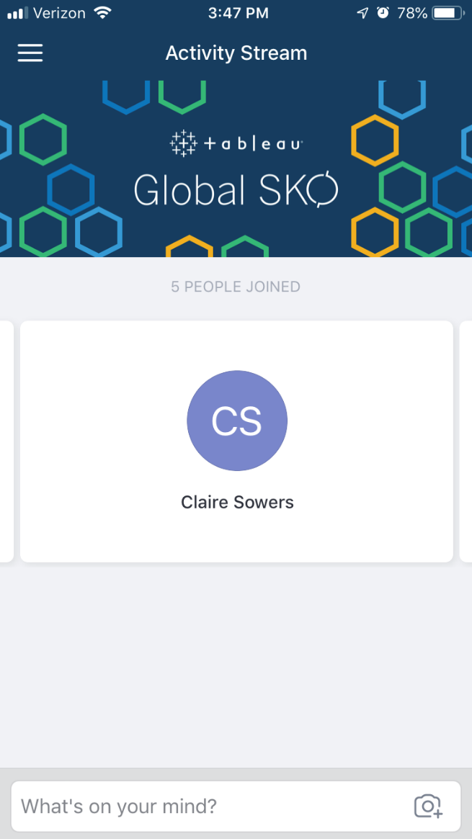
Global SKO Mobile App
Tell your audience to click on the app menu
Notes:
Click on your session

Slide 113
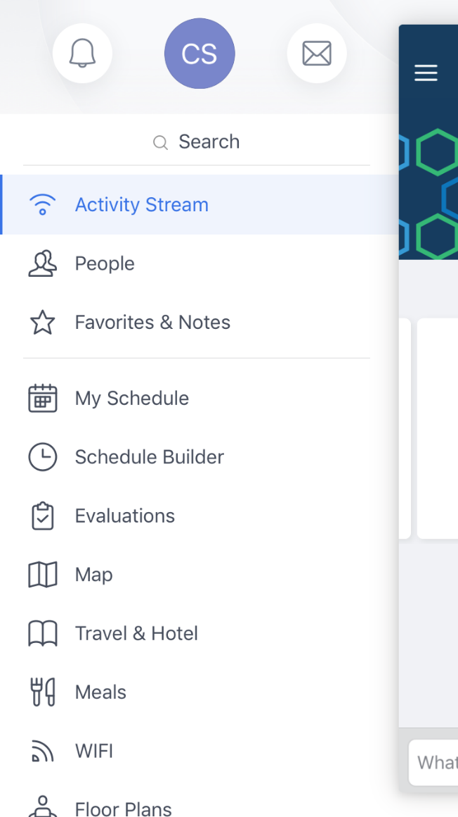
Global SKO Mobile App
And then click on “Evaluations” in the app menu on the left
Notes:
Click on your session

Slide 114
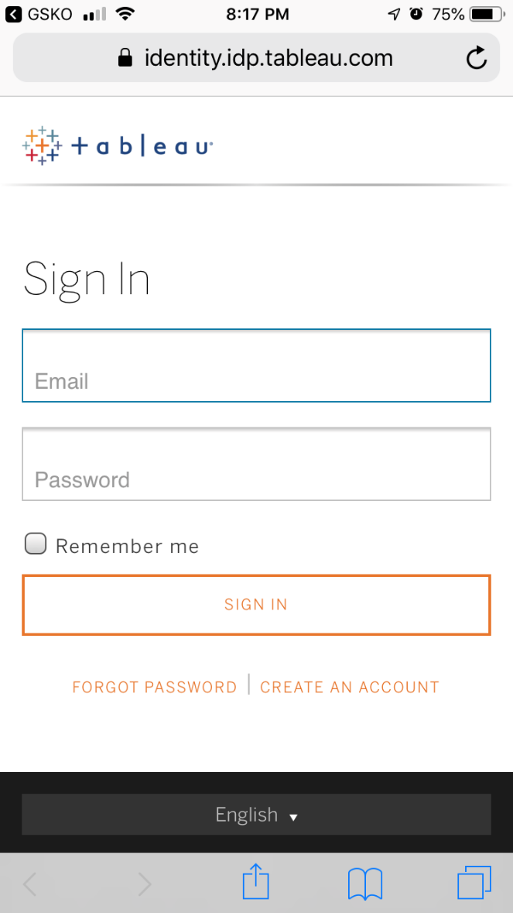
Global SKO Mobile App
They will be prompted to sign into Hubb
They will then see the full list of sessions they signed up to attend at GSKO
Tell them to click on your session to complete the evaluation
Notes:
Then click “Rate Now”

